Slide 1
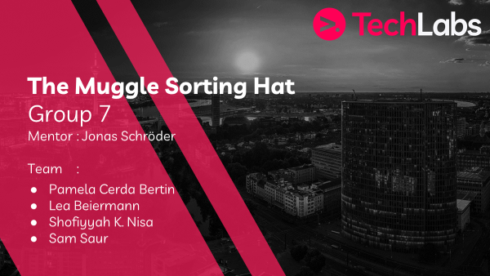

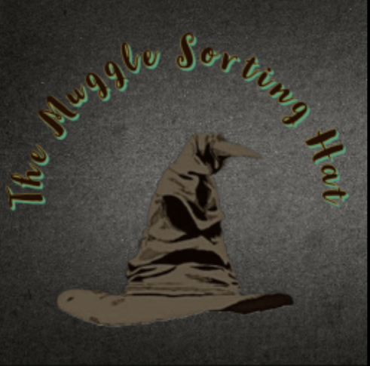
The Muggle Sorting Hat – Group 7

Slide 2
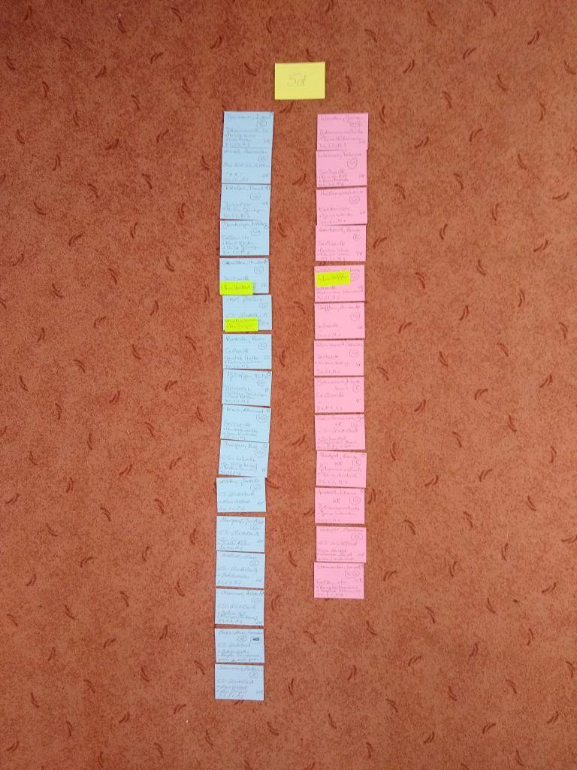
Idea & Project Outline
The Muggle Sorting Hat – Group 7
Our inspiration for our project was a team member’s mother
Create classes
Creating a dataset and grouping students with clustering – scikit learn, NetworkX, Streamlit
Clustering alone was not going to be sufficient
- Creating dataset (3 to 4 weeks) - forming the groups (5 weeks) - coding and integrating the personality test (4 weeks of coding – prep-work of months before coding) - creating a workable GUI prototype (3 weeks)

Slide 3
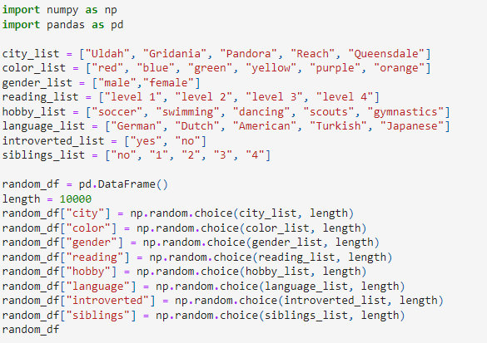



Problems & Solutions
The Muggle Sorting Hat – Group 7
Dataset creation, grouping the students, integration of the personality test
Getting started and finding a way to group the classes
Through the guidance of our mentor, and our brainstorming sessions
->
Excellent expertise, going above and beyond

Slide 4
Learnings
The Muggle Sorting Hat – Group 7
- Stress management, - collaboration through Github – a first for us, - time management
Use additional sources and resources
Hands-on coding and troubleshooting experience
Exceeded our expectations

Slide 5
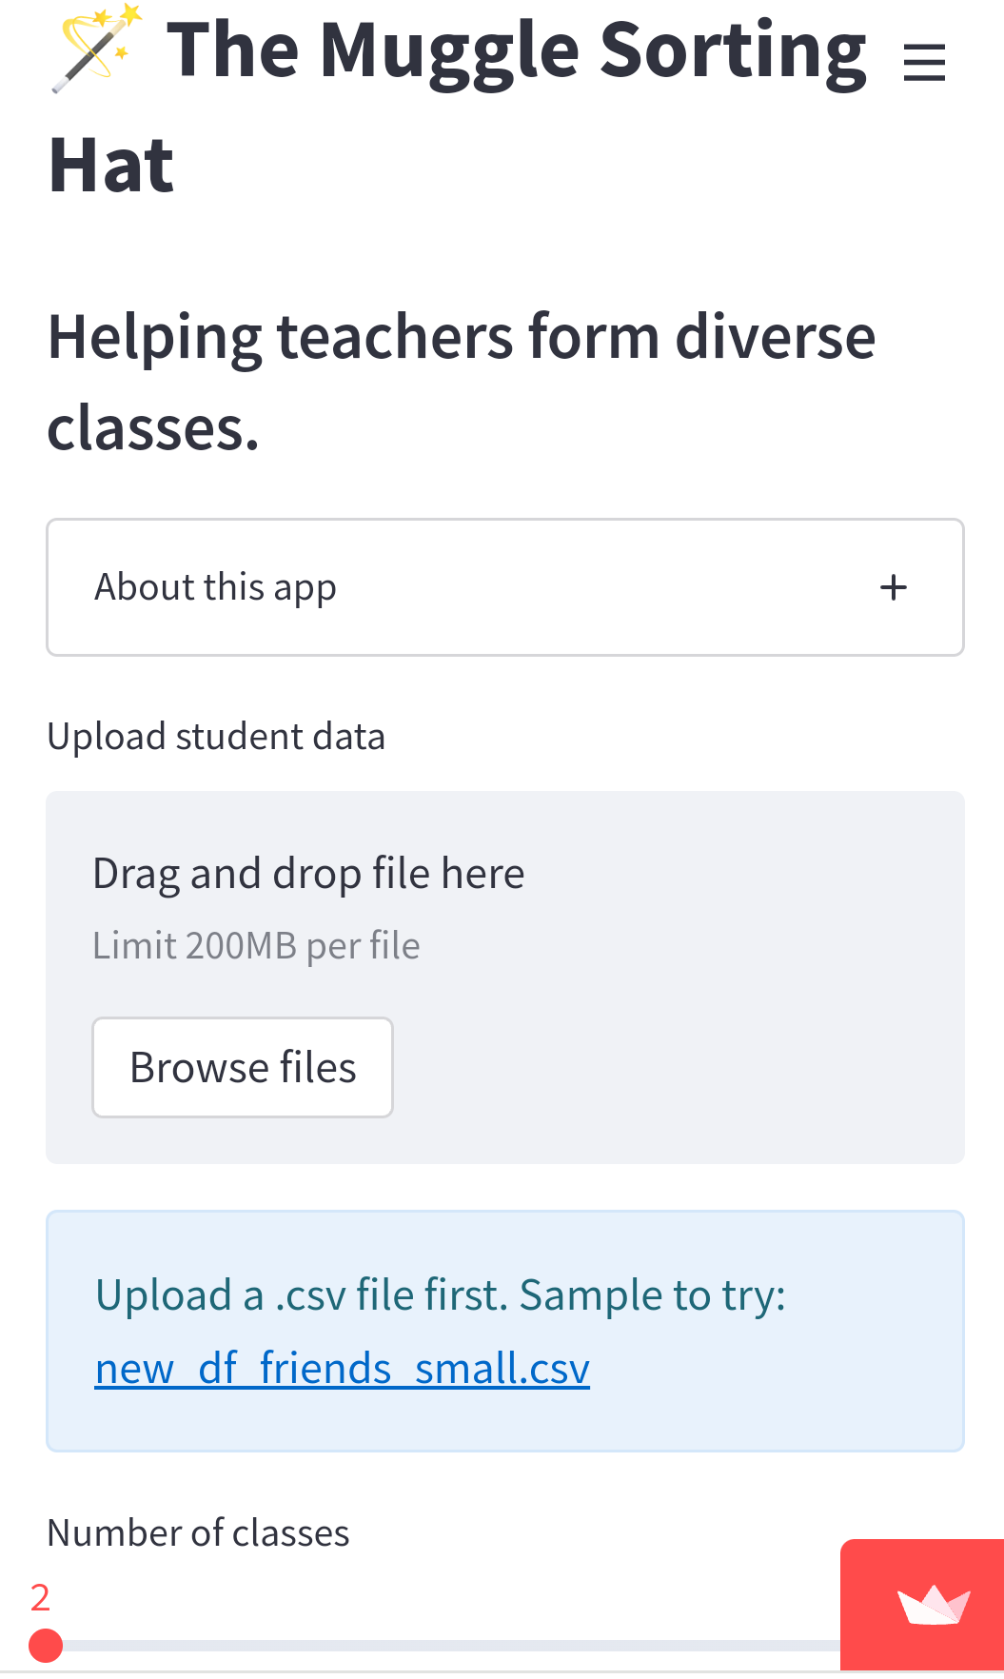
Demo
The Muggle Sorting Hat – Group 7
Our algorithm successfully creates new classes for the teachers. We also confirmed that the classes were as diverse as possible and that friends stay together. Furthermore, we were able to create a workable prototype of our algorithm with streamlit

Slide 6
Vision board
The Muggle Sorting Hat – Group 7
Bonus! We actually created a visual idea of what our completed app could look like

Slide 7
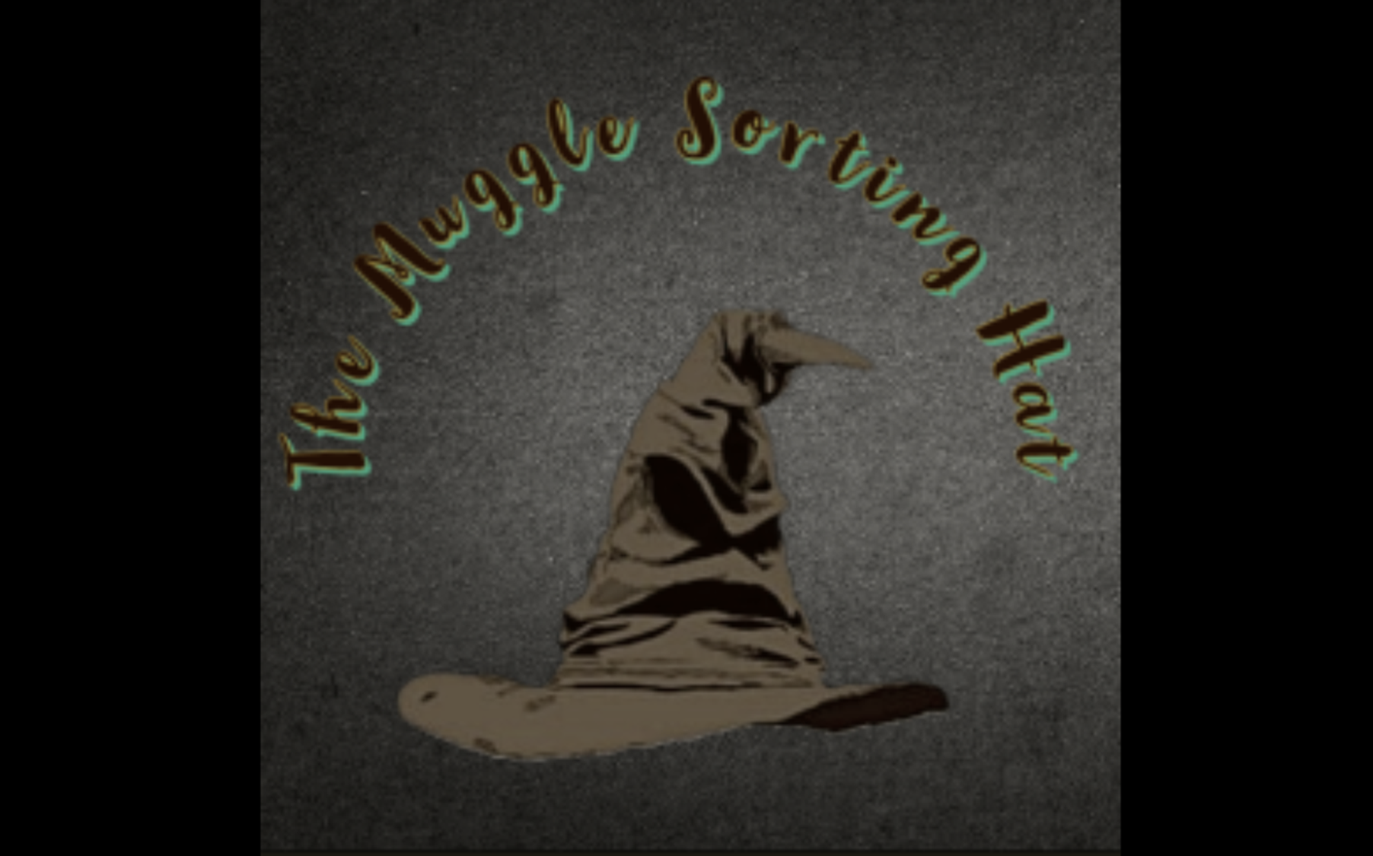
Bonus Content
The Muggle Sorting Hat – Group 7

Slide 8
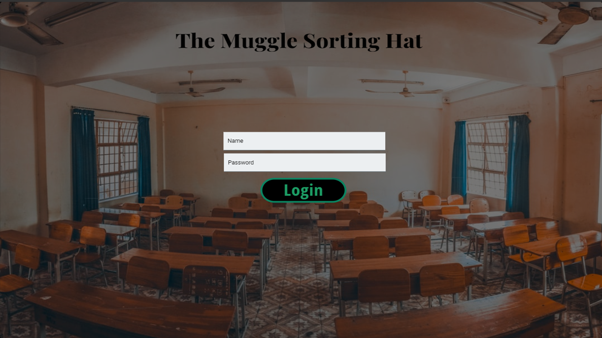
Bonus Content!
The Muggle Sorting Hat – Group 7

Slide 9
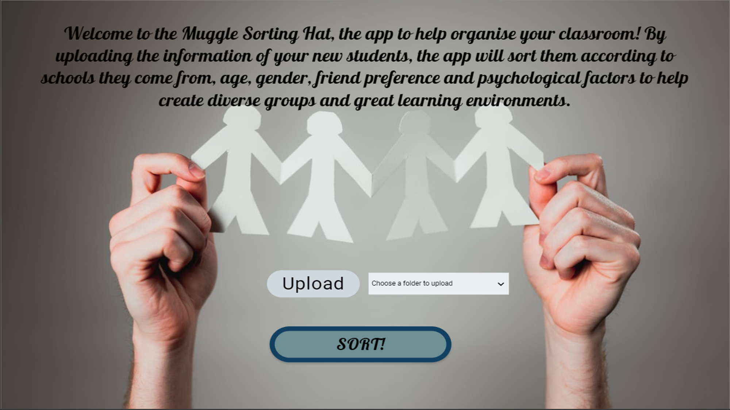
Bonus Content
The Muggle Sorting Hat – Group 7

Slide 10
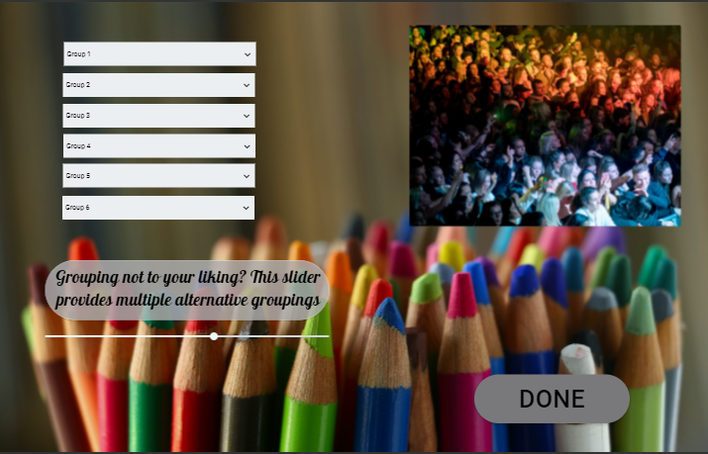
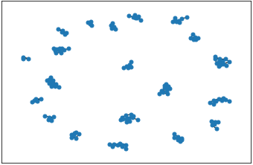
Bonus Content
The Muggle Sorting Hat – Group 7

Slide 11
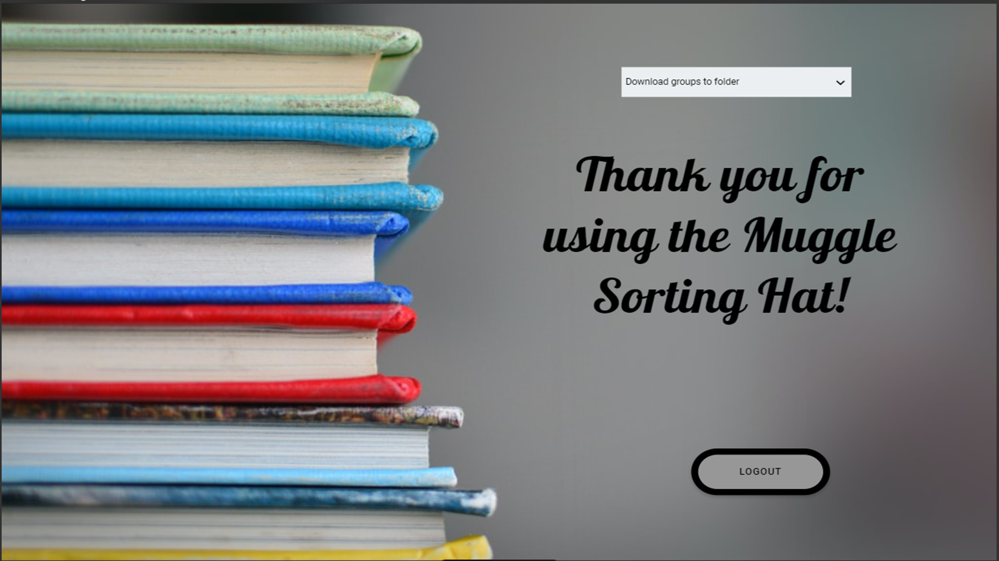
Bonus Content
The Muggle Sorting Hat – Group 7

Slide 12
Thank you for listening to our presentation
Does anyone have any questions?

